Slide 1
Contents
Terms
Distributed Database
Homogeneous & Heterogeneous Distributed Database
Query Processing & Optimization
Write Ahead Log, Synchronous Commit & Asynchronous Commit for SQL Server
Failover Clustering
Generic Connectivity for Oracle
DDBS Functionalities of SQL Server & Oracle
Cost Based Optimization & It’s Steps
Applications of SQL Server & Oracle in DDBS
Conclusion

Slide 2
Distributed Database
Database is a collection of data organized in such a way that, access to it is made easier to individuals. This database can be a collection of information on single machine or can be on a distributed network. And the concept of Distributed Database system is specifically related to the database spread over the interconnected network which is also known as federated database systems.
Following diagram depicts the concept of distributed database in deep.

Slide 3
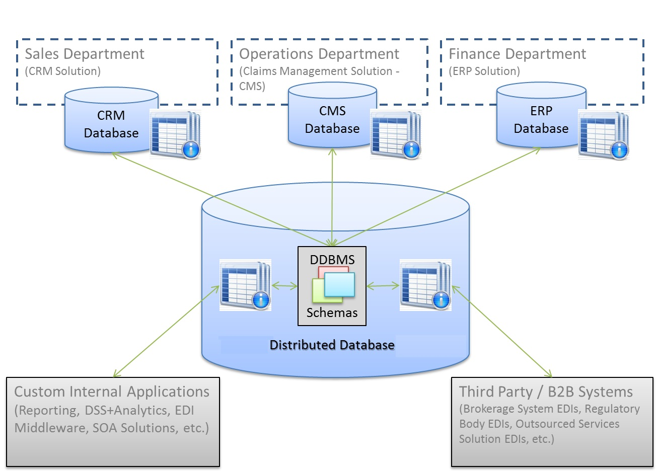
Figure depicts an example of heterogeneous database system where CRM Database, CMS Database and ERP Databases are inter-connected through middleware.
2. This middleware gives the actual distributed database schema.
3. Middleware also provides interface for different sites having different database engines for accessing database of centralized site.

Slide 4

Eeach site is autonomous processing site which is capable of performing local operations.
Each site also participates in the execution of central/global application which accesses the data at several sites.

Slide 5
Homogeneous Distributed Database
- (Identical database engines)
- Every site is agreed to process each other site’s requests.
- Database System appears to user as a single system which can process every type of user queries in order to generate the requested result
- This system provides a modular view of
- Each site gives it’s part of autonomy to other site which have a right to change the schemas or view

Slide 6
- Heterogeneous Distributed Database
Different sites involved has different software packages installed for database processing (Different Database Engines)
- Different sites involved has different software packages installed for database processing (Different Database Engines)
- It’s all up to the sites to provide the full access or the limited access to other sites

Slide 7
Terms - Query Processing and Optimization
Query Optimizer is important factor in relational Database Management Systems or Distributed DBMS. Whenever a user requests the data fetch operation, the request is generally expressed using a high-level and non-procedural condition in such a way that the result produced has to satisfy the user.
When such a request is processed, it’s the responsibility of query optimizer to create a plan for query evaluation also know as QEP(Query Evaluation Plan) referred by Johann Christoph Freytag.

Slide 8
Query Processing refers to building of database queries in such a way that, they will produce the desired data result by fetching the exact content out of database objects.
While building the queries according to the requirements of applications, there are multiple ways for setting up the queries in order to take out the desired results. And finding the best optimum solution for data-fetch operation is the term described as Query Optimization. At this point, an optimized query will give the output in minimum time frame.

Slide 9
As, optimized queries will produce the desired result in shortest time which can improve the functionalities of databases engines.
Query Optimization is achieved by means of Query Optimizer which works according to calculations of relational algebraic expressions or equivalent considerations.
Necessity of these calculations arises as there are again a multiple ways to optimize the query

Slide 10
Query Optimizer considers the following factors
The execution order of relational operations in database records
The algorithms designed for operations like JOIN’s
Order of movements of data in between different sites

Slide 11
Query Optimizer takes query as a input and will modulate it’s representation (representation of query) in a way to make it easier for optimization.
Optimizer will select appropriate strategy for optimization
distributed query is processed mainly on the basis of cost of execution time.

Slide 12
execution time is a calculus of time when the query is submitted and the result is evaluated.
Cost optimizers works in background for query cost evaluation.
Examples of Optimized Queries

Slide 13
Example 1:-
Query
SELECT count(subject), subject FROM student GROUP BY subject HAVING subject!= 'Physics' AND subject!= 'Mathematics';

Slide 14
Example 1
Query
SELECT count(subject), subject FROM student GROUP BY subject HAVING subject!= 'Physics' AND subject!= 'Mathematics';
Can be re-written as an Optimized Query
SELECT count(subject), subject FROM student WHERE subject != 'Physics' AND subject != ' Mathematics' GROUP BY subject;

Slide 15
Example 2 : -
SELECT name, Dob, Lname FROM employee WHERE salary = (SELECT MAX(salary), Lname, Fname FROM employee_details) AND age = (SELECT MAX(age) FROM employee_credentials) AND emp_dept = 'Information Technology';
Can be re-rewritten as an optimized query
SELECT name, Dob, Lname FROM employee WHERE (salary, age ) = (SELECT MAX (salary), Lname, Fname, MAX (age) FROM employee_ credentials) AND dept = ' Information Technology ';
It minimized the number of Subqueries

Slide 16
To achieve this optimization in distributed environment, let’s look at SQL Server functionalities.
Term Write Ahead Log
Wal_level (Wal log file) contains the information which is required for recovery if there is a crash or immediate system shutdown.

Slide 17
Failover Clustering
Whenever any of the system connected through network fails, failover cluster can be defined as a system in a network of interconnected computers which are working together which system increases the availability, performance and scalability of clustered application.
whenever one or more of the connected systems fails, other clustered (interconnected) systems starts to provide the services and this process is known as failover.

Slide 18
SQL Server defines the clustered systems through which we can incorporate & monitor clusters in order to increase availability of SQL server over distributed network
It also gives a way to connect system of interconnected networks by using Add Linked Server’s Option and there is one more way for connecting it to different systems by using Always On Availability Group

Slide 19
Always On Availability Group supports a set of a primary databases (defined cluster) and up to four sets of secondary databases.
This also supports a discreet set of read-write operations on connected databases.
Main benefit of using Always On Availability Group is that, it supports different types of failovers like automatic, planned, manual & even for availability group failovers

Slide 20
SQL Server Uses PCA (Principal Component Analysis) with SQL Server Query Optimizer which provides expert optimization for SQL Server.
The Query Optimizer of SQL Server is cost-based
Analyzes a different execution plans for provided query and calculates the cost for every plan and selects optimum plan
In fact, query optimizer can’t see for every possible solution for every query so it has to follow the cost calculation act before processing.

Slide 21
The biggest challenge in query optimization is cost estimations
Joins ordering is one more obstacle in processing
It’s the responsibility of DBA to state JOIN operations of tables in a way to make it easier for Optimization.
SQL Server - There are many ways for optimization
SQL Database Structure Optimization, Application Optimization & Language Optimization

Slide 22
Structure Optimization strategy checks whether the indexes of database tables are structured correctly or not. By creating and resetting the appropriate indexes, query optimization is increased by 10 times.
Application Optimization is achieved in SQL server by its existing capability of revealing application code which requests all over related data. – Important as multiple running applications can cause network blocking and timeouts in databases.
Language Optimization helps in designing databases in a way which avoids needless joins, un-necessary user defined functions or groupings in queries.

Slide 23
Oracle uses the term Generic Connectivity for establishing connection to network
Locally created database server splits up the distributed query in number of remotely fired queries and then it sends them to the remotely connected systems
Oracle also uses Optimizer Statistics like SQL Server for producing optimum results through distributed queries.

Slide 24
One way to optimize the distributed query is to minimize the remote database access and fetch only the required data.
Example of Cost Based Optimization in SQL Server & Oracle (DDBS)
CREATE TABLE UnOptimized AS (
SELECT loc.a, loc.b, rem1.c, rem1.d, rem1.e, rem2.b, rem2.c
FROM local loc, remote1 rem1, remote2 rem2
WHERE loc.c = rem1.c
AND rem1.c = rem2.c
AND rem2.e > 300
);

Slide 25
CREATE TABLE Optimized AS (
SELECT loc.a, loc.b, v.c, v.d, v.e
FROM
(SELECT rem1.c, rem1.d, rem1.e, rem2.b, rem2.c FROM remote1 rem1, remote2 rem2 WHERE rem1.c = rem2.c AND rem1.e > 300 )v, local loc WHERE loc.c = rem1.c );
v is used as an alias for created inline view.
Creating a view in such a way will reduce the total amount of performed queries at a remotely situated site which will reduce the network bytes transfer cost.

Slide 26
Applications which uses Distributed Query Optimization using SQL server and Oracle
- Distributed Client Server Web Applications
- Remotely Located Data Warehouses
- Privately Owned Client’s Project located at multiple sites

Slide 27
Conclusion
- Query processing with optimization contribute heavily for both of the database engines performance in distributed environment.
- Existing functionalities of SQL Server & Oracle can be used effectively in distributed environments

